Slide 1
How to I Manage My Own Code?
How do I create my OWN Package!

Slide 2
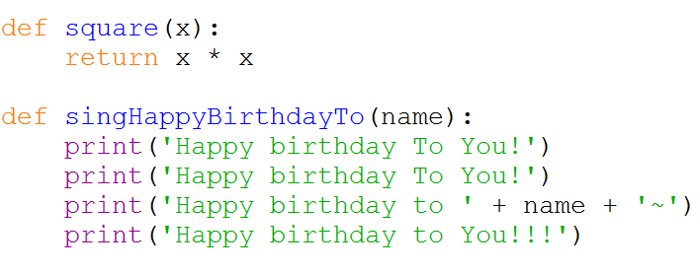

Let’s say I wrote some cool code
And I save it to a file called
my_cool_package.py

Slide 3
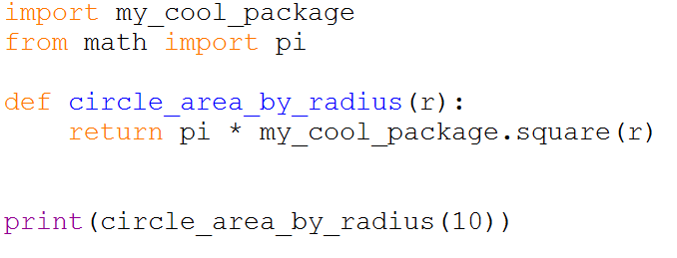
Then I can use it for another file
Same as the file name but without “.py”
(provided that they are in the same directory)
Another file:

Slide 4
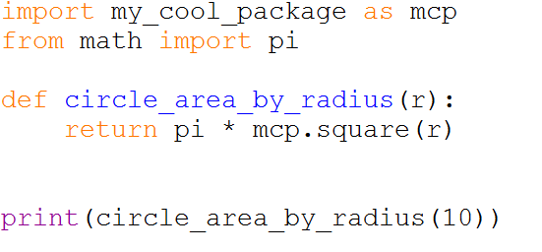
Or
Another file:

Slide 5
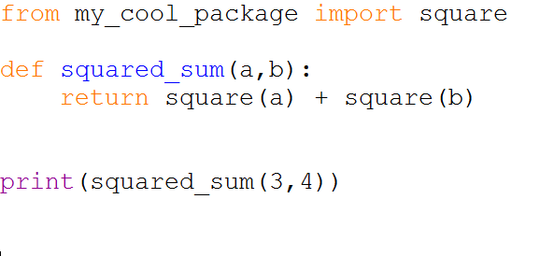
Or
Another file

Slide 6
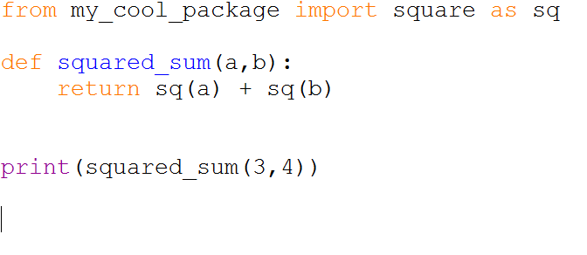
Or
But in general, it’s not a good habit to name a variable/function so short that you cannot understand what it does
Another file

Slide 7
OOP Assignment: RPG!

Slide 8
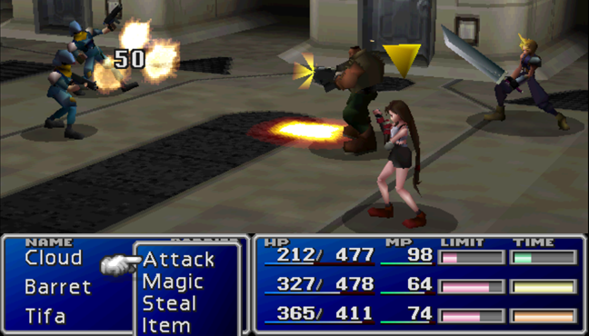
Introduction
We play a lot of RPG games nowadays like Final Fantasy, World of Warcrafts or DOTA. In this assignment, you are going to implement the characters for a turn-based RPG.

Slide 9
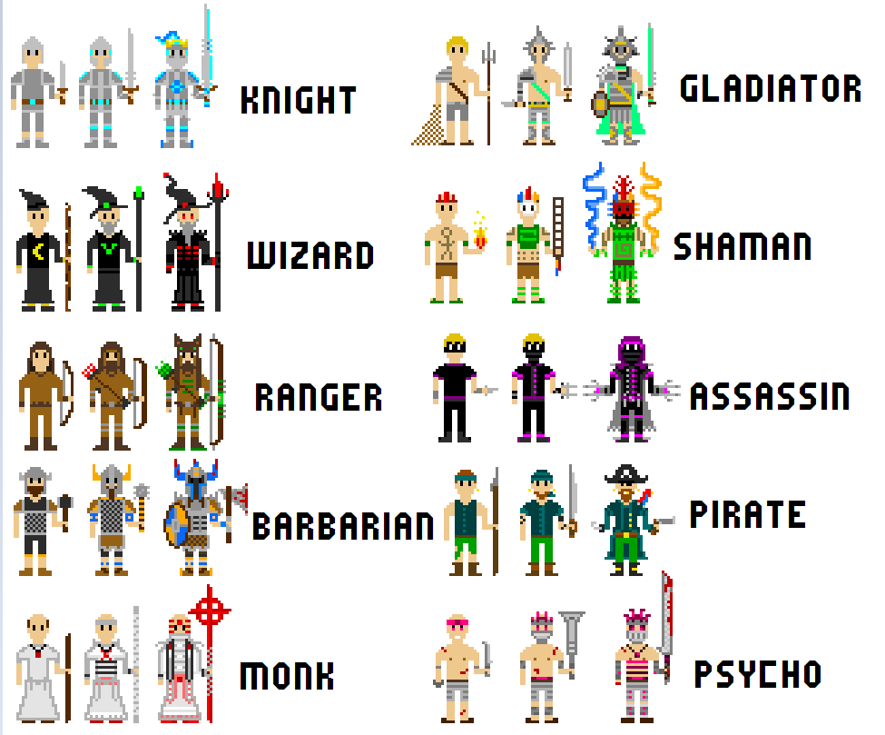
Type/Class of Characters
The game is a fight between two teams of adventurers formed by different types of characters
The jargon should be “classes” but we do not want to be confused with the “class” in Python

Slide 10
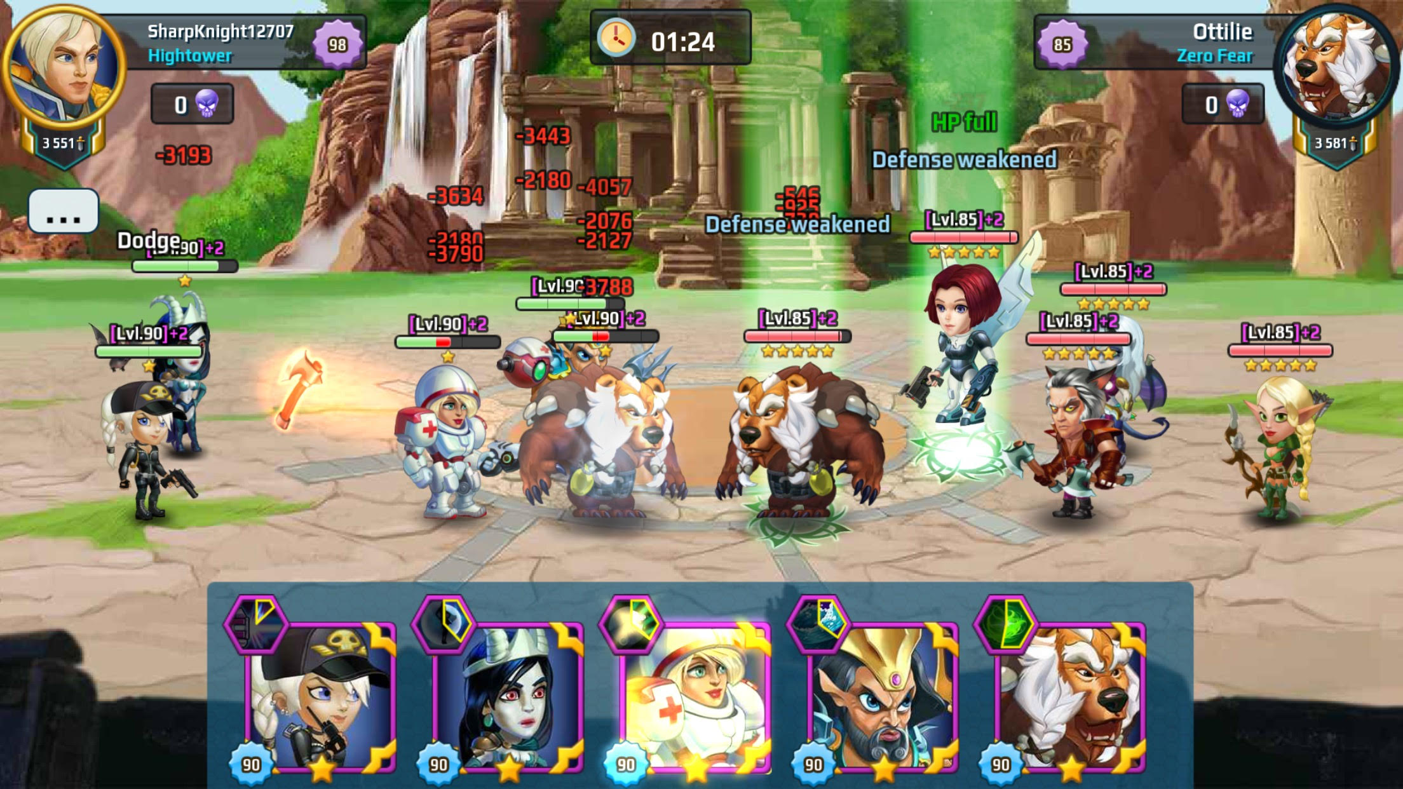
Introduction
You are given a battle system that can let two teams fight each other until one team won by destroying all the characters in the other team.

Slide 11
Introduction
You are given a battle system that can let two teams fight each other until one team won by destroying all the characters in the other team.
The good thing is that, the battle system is already implemented for you.
You only have to implement some new types of characters.
You can choose to run the file battle.py to start the game and try it out or by
gameStart(200,False)

Slide 12
Before the Battle
You are given some amount of gold (The default setting is 200 gold in the skeleton file)
Every type of characters has a cost and you can recruit a team with any combinations of them within your budget. And each team has to use up all the gold to form.
A random team formed by createRandTeam() will create a team as your enemy.
Then you can recruit your own team by choosing available type of characters by the function userChooseTeam(). In the battle, you will be Team A and your enemy will be Team B.

Slide 13
Before the Battle
createRandTeam()
Then you can recruit your own team by choosing available type of characters by the function userChooseTeam().
Your enemy will be:
Members: | Mage
Hitpoints: | 800
Strength: |
Max. Mana: | 50
Currnet M: | 50
Your current team:
(Currently no member in the team now)
You have 200 gold currently
Choices:
1: Fighter (cost: 100)
2: Mage (cost: 200)
Input a choice from 1 to 2:

Slide 14
Battle Starts
THE BATTLE STARTS!!!!!
Round 1
Team A:
Members: | Fighter| Fighter
Hitpoints: | 1200| 1200
Strength: | 100| 100
Max. Mana: | |
Currnet M: | |
Team B:
Members: | Mage
Hitpoints: | 800
Strength: |
Max. Mana: | 50
Currnet M: | 50
Team A member 1 Fighter acts
Hurt enemy 0 by damage 100.
Mage hurt with remaining hp 700.
Once the battle starts, each team will take turns to act.
However, one character can perform an action for one turn.
A character will be chosen at random within those are still alive in the team and he will perform an action targeted at a random enemy that is alive.
randAlive()
However, the last class Necromancer has an ability to “target” your own team also!

Slide 15
Battle Starts
THE BATTLE STARTS!!!!!
Round 1
Team A:
Members: | Fighter| Fighter
Hitpoints: | 1200| 1200
Strength: | 100| 100
Max. Mana: | |
Currnet M: | |
Team B:
Members: | Mage
Hitpoints: | 800
Strength: |
Max. Mana: | 50
Currnet M: | 50
Team A member 1 Fighter acts
Hurt enemy 0 by damage 100.
Mage hurt with remaining hp 700.
So, when a character acts, he will hurt a targeted enemy
And the enemy got hurt by gotHurt().
When the targeted enemy’s hp (hitpoint) drops to zero, he will be dead and no longer acts….
(Unless, a necromancer revives him afterwards.)

Slide 16
An Example Battle

Slide 17
Round 1
Team A:
Members: | Fighter| Mage|Necromancer| Fighter
Hitpoints: | 1200| 800| 800| 1200
Strength: | 100| | | 100
Max. Mana: | | 50| 50|
Currnet M: | | 50| 50|
Team B:
Members: | ArchMage| Berserker
Hitpoints: | 800| 1200
Strength: | | 100
Max. Mana: | 50|
Currnet M: | 50|
Team A member 0 Fighter acts
Hurt enemy 1 by damage 100.
Berserker hurt with remaining hp 1100.

Slide 18
Team A:
Members: | Fighter| Mage|Necromancer| Fighter
Hitpoints: | 1200| 800| 800| 1200
Strength: | 100| | | 100
Max. Mana: | | 50| 50|
Currnet M: | | 50| 50|
Team B:
Members: | ArchMage| Berserker
Hitpoints: | 800| 1100
Strength: | | 100
Max. Mana: | 50|
Currnet M: | 50|
Team B member 0 ArchMage acts
Strike enemy 3 with spell
Fighter hurt with remaining hp 800.

Slide 19
Round 2
Team A:
Members: | Fighter| Mage|Necromancer| Fighter
Hitpoints: | 1200| 800| 800| 800
Strength: | 100| | | 100
Max. Mana: | | 50| 50|
Currnet M: | | 50| 50|
Team B:
Members: | ArchMage| Berserker
Hitpoints: | 800| 1100
Strength: | | 100
Max. Mana: | 50|
Currnet M: | 30|
Team A member 0 Fighter acts
Hurt enemy 0 by damage 100.
ArchMage hurt with remaining hp 700.
(and the battle goes on….)

Slide 20
Details of the Battle
The details of the battle maybe too “annoying” and slow
The battle information for each turn is printed by the function “dprint()” rather than the normal “print()”
In which, you can turn on or off by the global variable “printActionDescription”
If “printActionDescription” is false, it will directly tell you which team win after the battle starts
Namely, skipping all the details
printActionDescription = True
def dprint(s):
if printActionDescription:
print(s)

Slide 21
Character Type (Classes)

Slide 22


Slide 23
Character Classes
We will have five different character classes, namely, Fighter, Mage, Berserker, ArchMage and Necromancer.
Given: Fighter and Mage

Slide 24
Base Class: Character
class Character(object):
def __init__(self):
self.name = ''
self.maxhp = 1000
self.hp = 1000
self.str = 0
self.maxmana = 0
self.mana = 0
self.cost = 9999999999
self.alive = True
def act(self,myTeam,enemy):
return
def gotHurt(self,damage):
if damage >= self.hp:
self.hp = 0
self.alive = False
dprint(self.name + ' died!')
else:
self.hp -= damage
dprint(self.name +
f' hurt with remaining hp {self.hp}.')
A Character is the base class of all characters
Initialization of the stats
Will do nothing
When he got hurt, he will either
Reduce his hp, or
Died if the damage is greater than the current hp

Slide 25
Base Class: Character
class Character(object):
def __init__(self):
self.name = ''
self.maxhp = 1000
self.hp = 1000
self.str = 0
self.maxmana = 0
self.mana = 0
self.cost = 9999999999
self.alive = True
def act(self,myTeam,enemy):
return
def gotHurt(self,damage):
if damage >= self.hp:
self.hp = 0
self.alive = False
dprint(self.name + ' died!')
else:
self.hp -= damage
dprint(self.name +
f' hurt with remaining hp {self.hp}.')
A Character is the base class of all characters
Initialization of the stats
Will do nothing
When he got hurt, he will either
Reduce his hp, or
Died if the damage is greater than the current hp

Slide 26
Base Class: Character
class Character(object):
def __init__(self):
self.name = ''
self.maxhp = 1000
self.hp = 1000
self.str = 0
self.maxmana = 0
self.mana = 0
self.cost = 9999999999
self.alive = True
def act(self,myTeam,enemy):
return
def gotHurt(self,damage):
if damage >= self.hp:
self.hp = 0
self.alive = False
dprint(self.name + ' died!')
else:
self.hp -= damage
dprint(self.name +
f' hurt with remaining hp {self.hp}.')
A Character is the base class of all characters
Initialization of the stats
Will do nothing
When he got hurt, he will either
Reduce his hp, or
Died if the damage is greater than the current hp

Slide 27
Base Class: Character
class Character(object):
def __init__(self):
self.name = ''
self.maxhp = 1000
self.hp = 1000
self.str = 0
self.maxmana = 0
self.mana = 0
self.cost = 9999999999
self.alive = True
def act(self,myTeam,enemy):
return
def gotHurt(self,damage):
if damage >= self.hp:
self.hp = 0
self.alive = False
dprint(self.name + ' died!')
else:
self.hp -= damage
dprint(self.name +
f' hurt with remaining hp {self.hp}.')
A Character is the base class of all characters
Initialization of the stats
Will do nothing
When he got hurt, he will either
Reduce his hp, or
Died if the damage is greater than the current hp

Slide 28
Fighter Class: Subclass of Character
A Fighter has a maximum hp of 1200 and strength 100.
He has a cost of 100 gold.
During each turn in the battle, he will select a random enemy and inflict a damage equal to his strength, i.e. 100 hp.
class Fighter(Character):
def __init__(self):
super().__init__()
self.name = 'Fighter'
self.maxhp = 1200
self.hp = 1200
self.str = 100
self.cost = 100
def act(self,myTeam,enemy):
target = randAlive(enemy)
dprint(f'Hurt enemy {target} by damage {self.str}.')
enemy[target].gotHurt(self.str)

Slide 29
Fighter Class: Subclass of Character
A Fighter has a maximum hp of 1200 and strength 100.
He has a cost of 100 gold.
During each turn in the battle, he will select a random enemy and inflict a damage equal to his strength, i.e. 100 hp.
class Fighter(Character):
def __init__(self):
super().__init__()
self.name = 'Fighter'
self.maxhp = 1200
self.hp = 1200
self.str = 100
self.cost = 100
def act(self,myTeam,enemy):
target = randAlive(enemy)
dprint(f'Hurt enemy {target} by damage {self.str}.')
enemy[target].gotHurt(self.str)

Slide 30
Mage Class
class Mage(Character):
def __init__(self):
super().__init__()
self.name = 'Mage'
self.maxmana = 50
self.mana = 50
self.hp = 800
self.cost = 200
self.int = 400
Basic Statistics
He will cast a spell in his turn and make a damage that is equal to his intelligence.
However, casting a spell needs 20 mana.
If his remaining mana is less than that, he will take the turn to meditate to gain a recovery of 30 mana points instead.
Namely, he will not cast a spell to hurt an enemy on that turn.
def act(self,myTeam,enemy):
if self.mana < manaCost:
self.mana += manaRecovery
dprint(f'Mana recover to {self.mana}.')
else:
self.cast(myTeam,enemy)
def cast(self,myTeam,enemy):
self.mana -= manaCost
target = randAlive(enemy)
dprint(f'Strike enemy {target} with spell')
enemy[target].gotHurt(self.int

Slide 31
A Team

Slide 32
Creating a Team
Give the amount of gold you can use, you can create a team by either one of the functions below:
createRandTeam(gold)
Create a random team
userChooseTeam(gold)
Ask the user to choose characters to “buy” into your team
No matter which function you used, a team is a list of instances of Characters, Fighters or Mages, (or other characters you created)

Slide 33
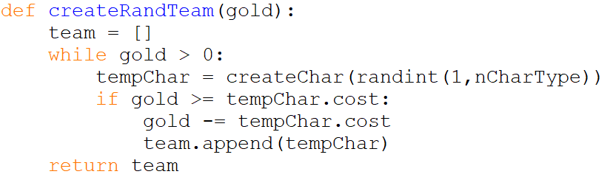
Example
Create a Random Team for the Computer
Please read the code of userChooseTeam().

Slide 34


Slide 35
Adding New Classes
(Berserker)

Slide 36
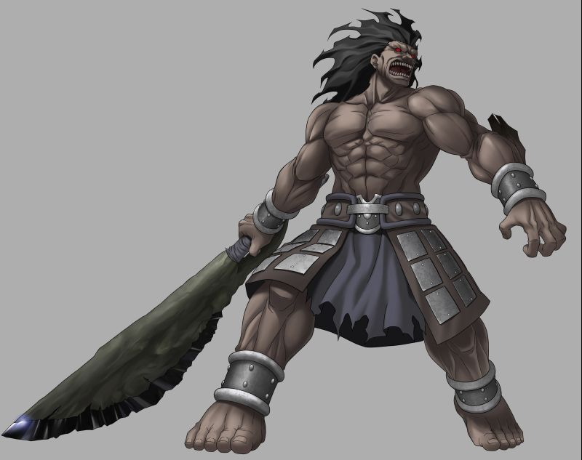
Berserker
In the Old Norse written corpus, berserkers (or "berserks"; Old Norse: berserkir) were warriors who purportedly fought in a trance-like fury, a characteristic which later gave rise to the modern English word "berserk " or ``Berzerk `` .

Slide 37
Berserker Class in Our Game
A Berserker is a Fighter but he costs 200 gold.
However, if his hit point is lower than or equal to half of his maximum hp, he will enter the “berserk mode” and his strength will be doubled to 200.

Slide 38
Berserker Class in Our Game
Original Fighter class
How to modify: “Berserker is a Fighter but he costs 200 gold.”?
class Fighter(Character):
def __init__(self):
super().__init__()
self.name = 'Fighter'
self.maxhp = 1200
self.hp = 1200
self.str = 100
self.cost = 100
def act(self,myTeam,enemy):
target = randAlive(enemy)
dprint(f'Hurt enemy {target} by damage {self.str}.')
enemy[target].gotHurt(self.str)

Slide 39
Berserker Class in Our Game
Original Fighter class
How to modify: “ Berserker is a Fighter but he costs 200 gold. “
First called the Fighter class constructor to set all the attributes
Then change/overwrite the variables that is different from Fighter class
class Berserker(Fighter):
def __init__(self):
super().__init__()
self.name = 'Berserker'
self.cost = 200

Slide 40
Berserker Class in Our Game
“However, if his hit point is lower than or equal to half of his maximum hp, he will enter the “berserk mode” and his strength will be doubled to 200.”
When will it happen?
Only when he needs to “act()”
Change the strength attribute if the condition is met
Then perform what a Fighter do
class Berserker(Fighter):
def __init__(self):
super().__init__()
self.name = 'Berserker'
self.cost = 200
def act(self,myTeam,enemy):
if self.hp <= (self.maxhp//2):
self.str = 200
dprint('Beserk mode! Attack double!')
else:
self.str = 100
super().act(myTeam,enemy)

Slide 41
Berserker Class in Our Game
Note the difference between the orders of calling “super()”
Why are they different?
class Berserker(Fighter):
def __init__(self):
super().__init__()
self.name = 'Berserker'
self.cost = 200
def act(self,myTeam,enemy):
if self.hp <= (self.maxhp//2):
self.str = 200
dprint('Beserk mode! Attack double!')
else:
self.str = 100
super().act(myTeam,enemy)

Slide 42
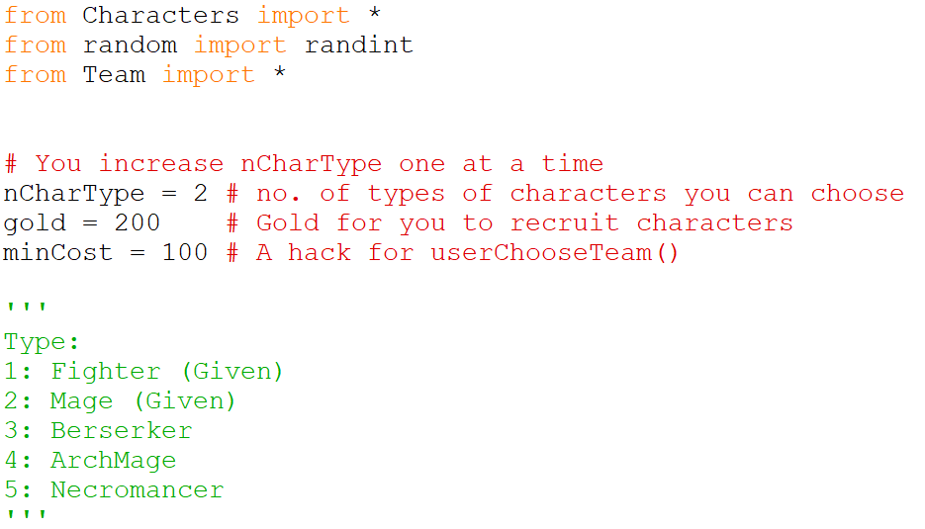
Adding Berserker into the System
The class Berserker is ready, but we need to add it to the system
Open the battle.py file
First, you need to increase the number of character type from 2 to 3

Slide 43
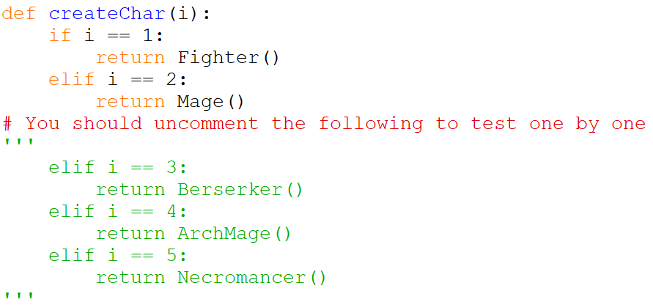
Adding Berserker into the System
Then, allow the user to choose 3 for Berserker when they create their team
Uncomment these two lines
And these two lines ONLY!

Slide 44
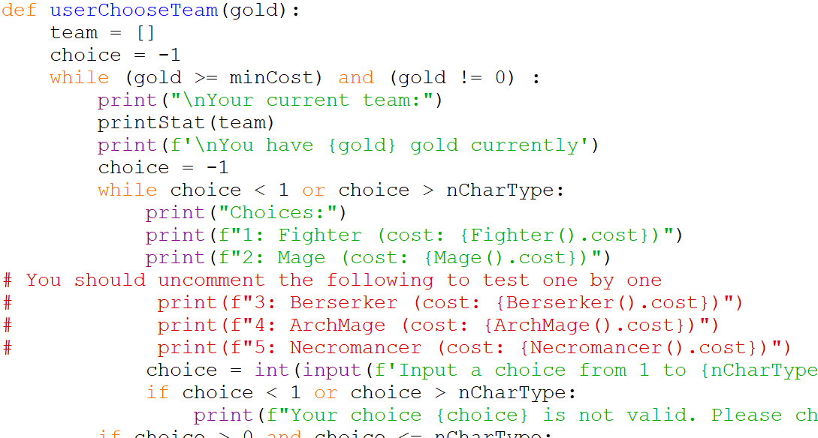
Adding Berserker into the System
And uncomment here:

Slide 45
Optional
You may want to change the default amount of gold that you can use
The default value is 200

Slide 46
Finish Berserker Implementation!
If you have not done it yet

Slide 47
Two More Classes!

Slide 48
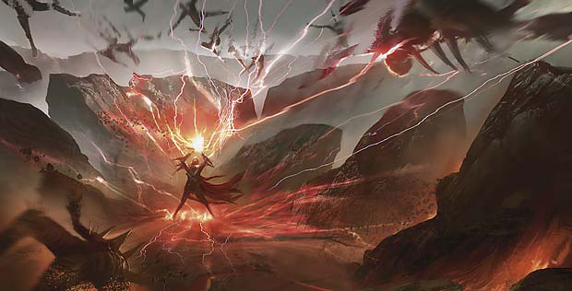
ArchMage
If you feel like the Mage is not powerful enough

Slide 49
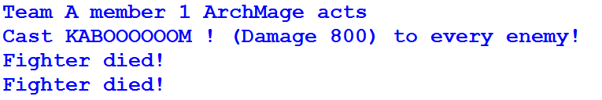
ArchMage
An ArchMage is a Mage but he costs 600.
However, if he is the only one alive in his own team,
he will cast the special spell KABOOM and it inflicts EVERY enemy alive with a damage of double of his intelligence, i.e. 800 hp!!!
However, this KABOOM spell also needs 20 mana to cast. Meaning, he has to waste a turn to meditate if his mana is lower than 20.
Sample “act” for ArchMage

Slide 50
ArchMage
How to check “if he is the only one alive in his own team”?
In the act() function, the two input parameters are
myTeam
enemy (Team)
In which, they are lists of Characters
And in each Character, there is an attribute “alive”
You can reference to the functions “allAlive()” and “allDead()” to understand how to check if a team is all alive or all dead

Slide 51
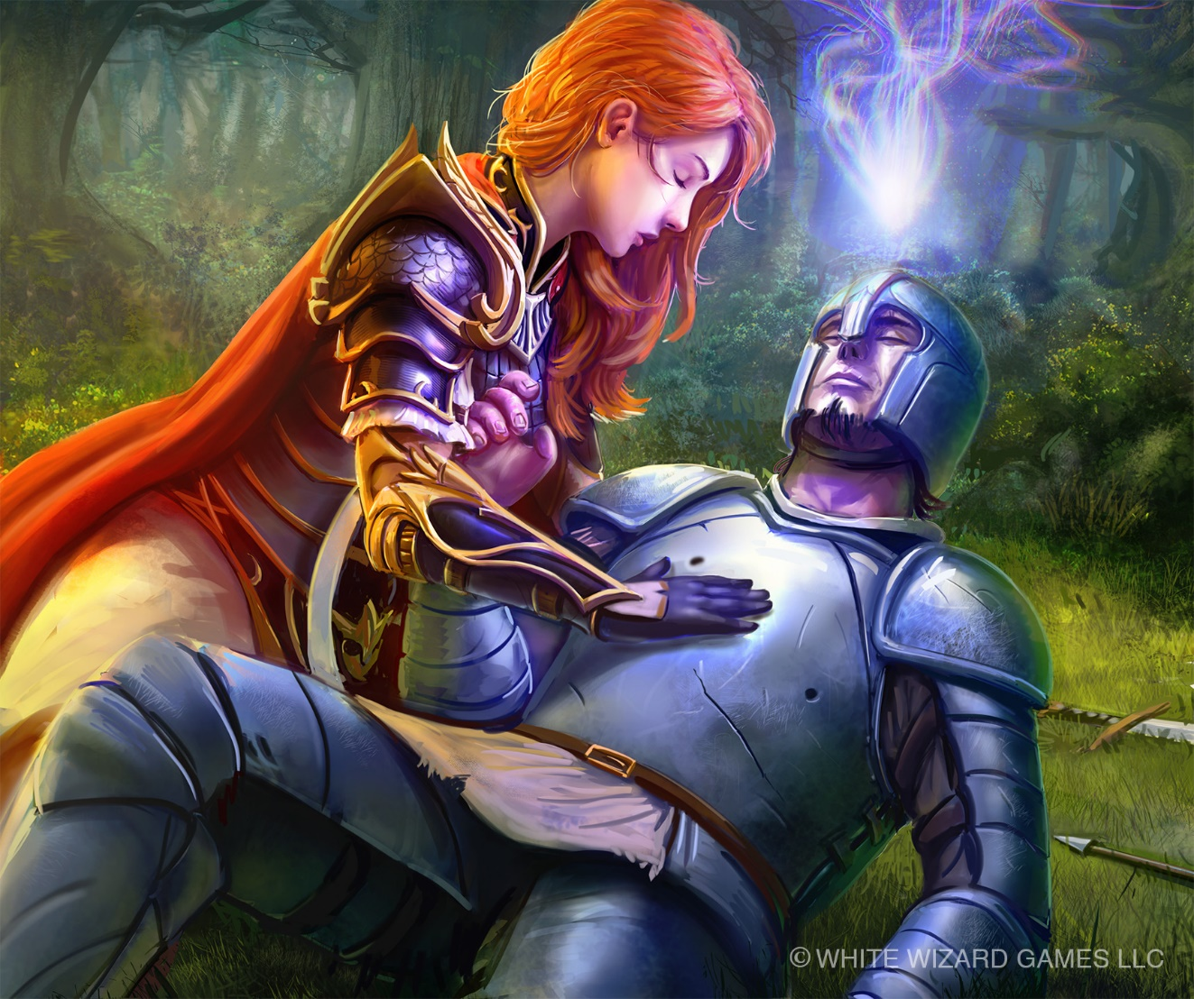

Necromancer
A Necromancer is a Mage but he costs 400.
However, if there are some dead members in his own team,
He can cast a spell “raise dead” with 20 mana to revive a random dead team member
And recover him half of his maximum hit point, instead of hurting his enemy in his turn.

Slide 52
Your Tasks
Your job is to implement the three remaining classes with inheritance.
Major changes all in characters.py
Minor changes in battle.py for adding more characters
No change should be done in team.py
More details on the worksheet

Slide 53
Submission
You should only copy and paste the classes for the three new characters into coursemology from the file characters.py.
And there will be no testing feedback for you because the game is random.

Slide 54
Tips
Design before you implement. Plan out your class inheritance diagram before you code, especially what are commons or not in each of the class relationship
Implement one class at a time
Make good use of the pause and dprint().
Make backup from time to time. Especially a copy of your code for each new character type you implemented
You cannot do any hard-coding. And you have to follow the way of OOP instead using other ways to get around, e.g. checking the Character’s name to choose what to do

Slide 55
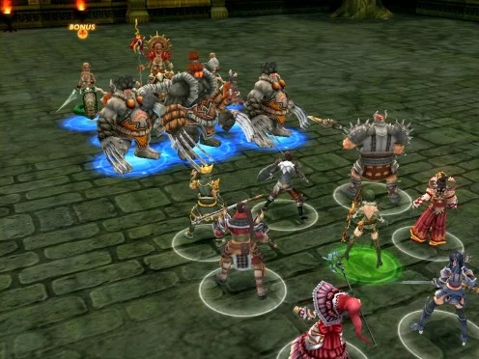
Extra Tasks
Finding the Best Team
If you are given certain amount of gold, say 1200, what should be the best team composition?
Create your new classes
Ranger? Assassin? Cleric? Bard?
Vampire?
Regenerate health when attack
Confused Fighter?
May have a %25 chance attack your own team
Battle Formation
Difference rows?

